Slide 1
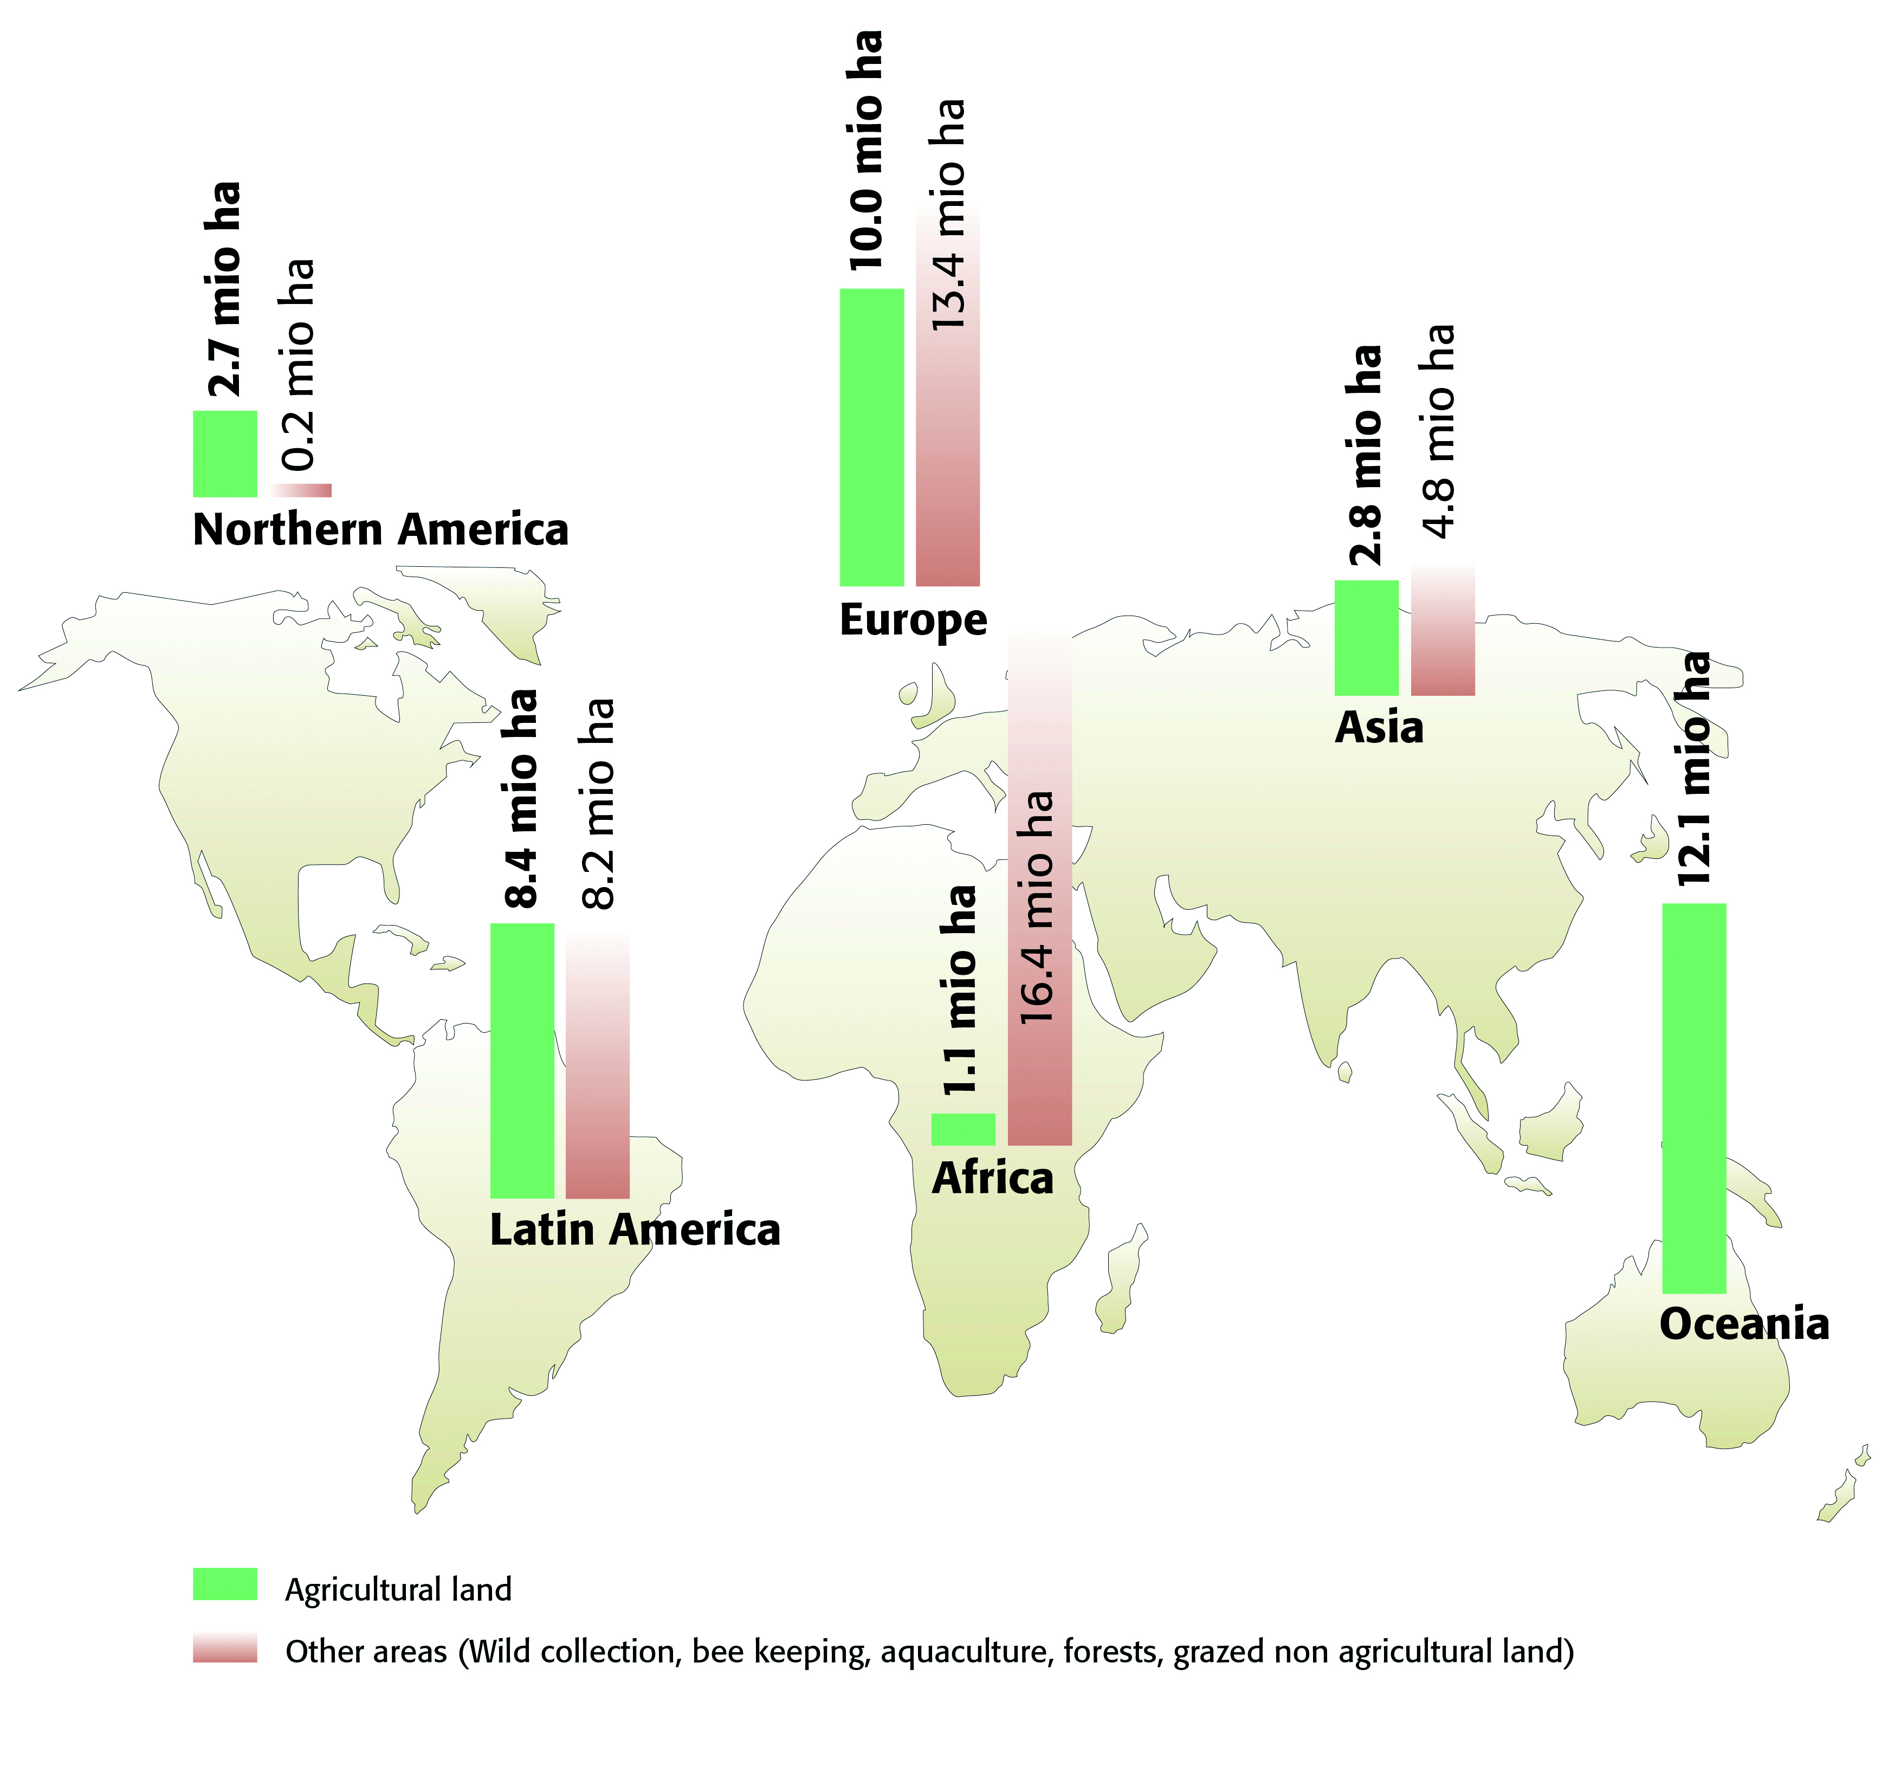
Organic agricultural land and other areas 2010
Source: FiBL-IFOAM Survey 2012, based on data from governments, the private sector and certifiers.

Slide 2
The ten countries with the most organic agricultural land 2010
Source: FiBL-IFOAM Survey 2012, based on data from governments, the private sector and certifiers.

Slide 3
Distribution of organic agricultural land by region 2010
Source: FiBL-IFOAM Survey 2012, based on data from governments, the private sector and certifiers.

Slide 4
The countries with the highest shares of organic agricultural land 2010
Source: FiBL-IFOAM Survey 2012, based on data from governments, the private sector and certifiers.

Slide 5
Distribution of organic shares 2010
Source: FiBL-IFOAM Survey 2012, based on data from governments, the private sector and certifiers.

Slide 6
Growth of the organic agricultural land 1999-2010
Source: FiBL-IFOAM-SOEL Surveys 2000-2012,based on data from governments, the private sector and certifiers.

Slide 7
Europe: Development of organic agricultural land 1985-2010
Source: Lampkin and FiBL, based on national data sources and Eurostat

Slide 8
The ten countries with the largest increase of organic farmland 2010
Source: FiBL-IFOAM Survey 2012, based on data from governments, the private sector and certifiers.

Slide 9
Distribution of organic producers by region 2010
Source: FiBL-IFOAM Survey 2012, based on data from governments, the private sector and certifiers.

Slide 10
The ten countries with the most organic producers 2010
Source: FiBL-IFOAM Survey 2012, based on data from governments, the private sector and certifiers.

Slide 11
The ten countries with the largest organic markets 2010 (total 44.5 billion Euros)
Source: FiBL-AMI Survey 2012, based on data from governments, the private sector and market research companies.

Slide 12
The ten countries with the highest per capita consumption 2010
Source: FiBL-AMI Survey 2012, based on data from governments, the private sector and market research companies.

