Slide 1
Biologische Landwirtschaft weltweit 2014 - Grafiken
Julia Lernoud and Helga Willer
Forschungsinstitut für biologischen Landbau (FiBL), Frick, Schweiz
10. Februar 2016

Slide 2
Development of the number of countries with data on organic agriculture

Slide 3
The ten countries with the largest organic agricultural land 2012

Slide 4
Distribution of organic agricultural land by region 2012

Slide 5
The ten countries with the highest shares of organic agricultural land 2012

Slide 6
Growth of the organic agricultural land 1999-2012

Slide 7
Growth of the organic agricultural land by continent 1999-2012

Slide 8
Growth of the organic agricultural land by continent 2005-2013

Slide 9
Growth of the organic land by land use type 2004-2013

Slide 10
The ten countries with the largest numbers of organic producers 2012

Slide 11
Organic producers by region 2012

Slide 12
The ten countries with the largest markets for organic food 2012

Slide 13
The ten countries with the largest per capita consumption for 2012

Slide 14
Global market: Distribution of total retail sales value by country

Slide 15
Global market: Distribution of total retail sales value by single markets (total: 47.8 billion) Euros 2013

Slide 17
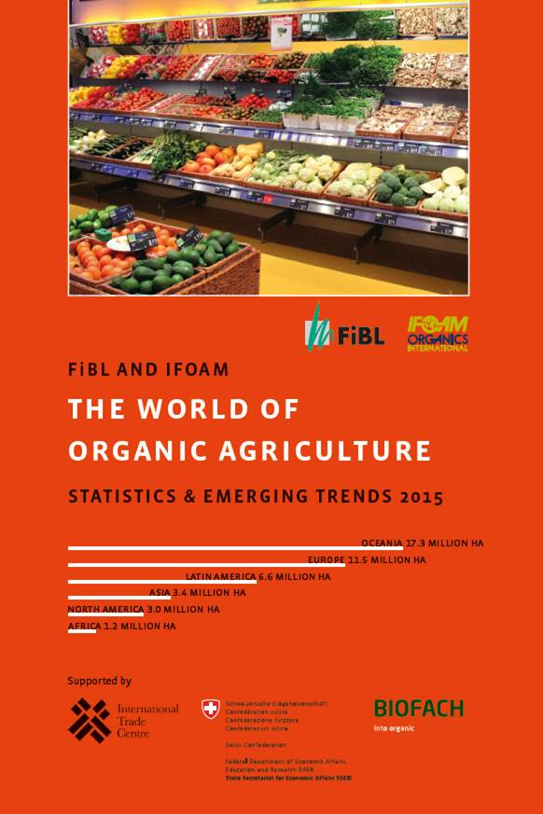
The World of Organic Agriculture, Ausgaben 2015 und 2016, www.organic-world.net

Slide 18
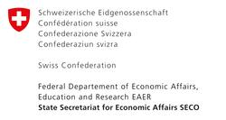
Unterstützung Datensammlung
Schweizer Staatssekretariat für Wirtschaft
International Trade Centre (ITC), Genf
Nürnberg Messe/BIOFACH
Ueber 200 Datenlieferanten weltweit

Slide 19
Kontakt
Helga Willer und Julia Lernoud
Forschungsinstitut für biologischen Landbau (FiBL)
Ackerstrasse 113, 5070 Frick, Schweiz
Tel. +41 79 218 0626, Fax +41 62 865 7273
helga.willer@fibl.org und julia.lernoud@fibl.org
www.fibl.org, www.organic-world.net
Willer, Helga und Julia Lernoud (Hrsg.) (2016): The World The World of Organic Agriculture. Statistics and Emerging Trends 2016. FiBL, Frick und IFOAM – Organics International, Bonn
http://www.organic-world.net/yearbook/yearbook-2016.html

