Slide 1
Organic Agriculture Worldwide 2014
Julia Lernoud and Helga Willer
Research Institute of Organic Agriculture (FiBL), Frick, Switzerland
February 10, 2016

Slide 2
Development of the number of countries with data on organic agriculture

Slide 3
The ten countries with the largest organic agricultural land 2012

Slide 4
Distribution of organic agricultural land by region 2012

Slide 5
The ten countries with the highest shares of organic agricultural land 2012

Slide 6
Growth of the organic agricultural land 1999-2012

Slide 7
Growth of the organic agricultural land by continent 1999-2012

Slide 8
Growth of the organic agricultural land by continent 2005-2013

Slide 9
Growth of the organic land by land use type 2004-2013

Slide 10
The ten countries with the largest numbers of organic producers 2012

Slide 11
Organic producers by region 2012

Slide 12
The ten countries with the largest markets for organic food 2012

Slide 13
The ten countries with the largest per capita consumption for 2012

Slide 14
Global market: Distribution of total retail sales value by country

Slide 15
Global market: Distribution of total retail sales value by single markets (total: 47.8 billion) Euros 2013

Slide 16
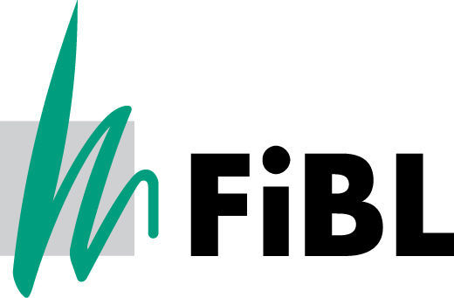

Slide 17
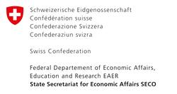
Acknowledgements
The Swiss State Secretariat of Economic Affairs SECO, Berne
International Trade Centre ITC
Nürnberg Messe, the organizers of the BioFach World Organic Trade Fair
200 experts from all parts of the world contributed to the FiBL-IFOAM survey 2014.

Slide 18
The World of Organic Agriculture 2016
The 17th edition of ‚The World of Organic Agriculture‘, was published by FiBL and IFOAM – Organics International in February 2016.*
Contents:
Results of the survey on organic agriculture worldwide;
Organic agriculture in the regions and country reports; Australia, Canada, the Pacific Islands, and The United States of America.
Chapters on the global market, standards & legislations, voluntary standards , PGS, European market, data collection in Thailand and Australia
Numerous tables and graphs.
New addittions: Better Data: highlights examples of how organic market data are collected and associated challenges Commomdity case studies: a section for the analysis of selected commodities
The book can be ordered via IFOAM.bio and shop.FiBL.org.
*Willer, H, Lernoud, J, (eds.) (2016) The World of Organic Agriculture. Statistics and Emerging Trends 2016. FiBL, Frick, and, IFOAM – Organics International, Bonn
http://www.organic-world.net/yearbook/yearbook-2016.html

Slide 19
Contact
Helga Willer and Julia Lernoud
Research Institute of Organic Agriculture (FiBL)
Ackerstrasse 113, 5070 Frick, Switzerland
Tel. +41 79 218 0626, Fax +41 62 865 7273
helga.willer@fibl.org und julia.lernoud@fibl.org
www.fibl.org, www.organic-world.net
Willer, Helga and Julia Lernoud (Eds.) (2016): The World The World of Organic Agriculture. Statistics and Emerging Trends 2016. FiBL, Frick and IFOAM – Organics International, Bonn
http://www.organic-world.net/yearbook/yearbook-2016.html

